Slide 1


Cyberbullying Detection
By:
John Hani
Mohamed Nashaat
Mostafa Ahmed
Zeyad Emad (Team Leader)
Under supervision of :
Dr. Eslam Amer
Eng. Menna Gamil

Slide 2



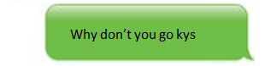
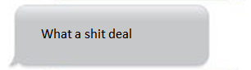
You’re
Trash
Personal pronoun used when directly addressing people
An offensive word when combined with personal pronouns creates a cyberbullying sample

Slide 3
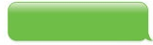
Why
Don’t
you
go
kys
Kys is a slang word which stand for kill yourself also considered as a cyberbullying sample
http://www.noswearing.com/dictionary

Slide 4
What
a
deal
A rather offensive word but no pronouns were found in that sentence implying the sentiment of discomfort or irritation

Slide 5
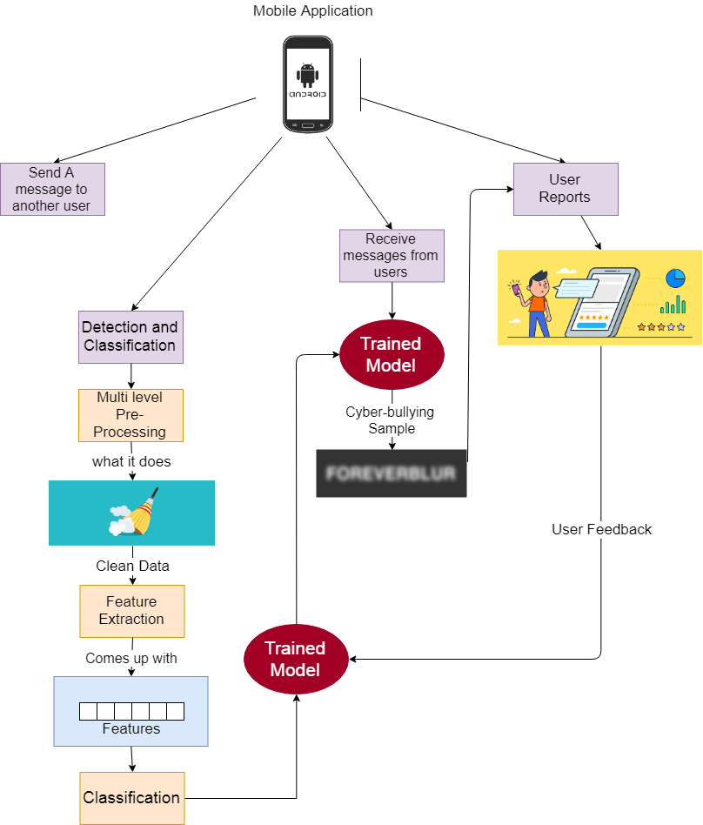

Slide 6
Objective
In previous cyberbullying detection frameworks there has been a problem in detecting false positive cyberbullied cases.
The accuracy in these papers is not high enough and could be improved.

Slide 7
Functional Requirement
User | Login Sign Up Update Logout Rating
Messages | Send messages & Receive messages Encrypt & Decrypt Copy & Paste message
Processing | Preprocessing Feature extraction Classification
System | Notify Result Upgrade Classifier

Slide 8



Non Functional Requirements
Security
Maintainability
Portability
Have Encryption and Decryption
Self Learning
Both Desktop and Android

Slide 9
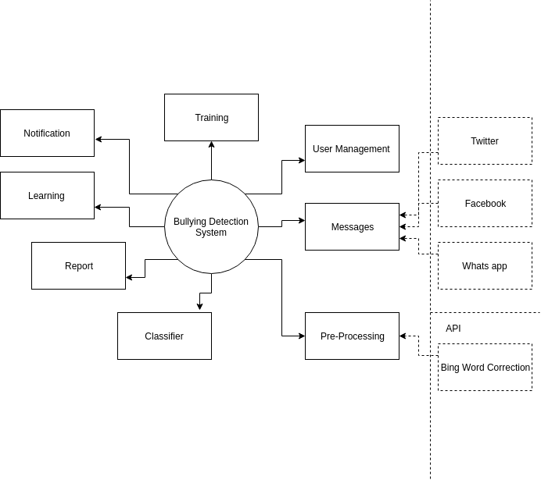
Context Diagram

Slide 10
User Management: Responsible for the Management of the Users Roles
Pre-Processing: Limitization, Stemming,Tokenization, Word Correction Bing API for correction
Processing: (SVM , Random Forest, Naive Bayes)
Reports: Are automatically generated reports about the system overall the number of bully message detected , etc…
Learning: Self-Learning for the system based on the decision taken by the supervisor about the user rating
Notification: Notify the user about the new messages and bully messages received
Training: Train the model by data set or wrong classification
Messages: Receive messages from Twitter, Facebook , Whatsapp API

Slide 11
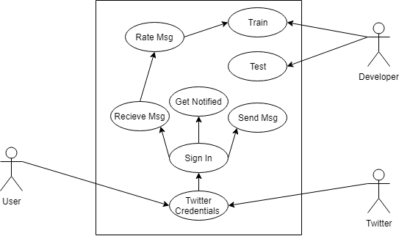
Use Case

Slide 12
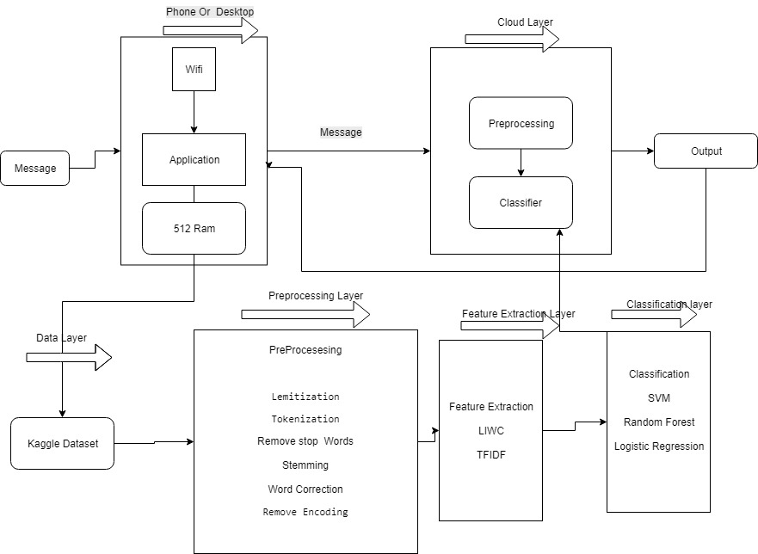
Block Diagram

Slide 13
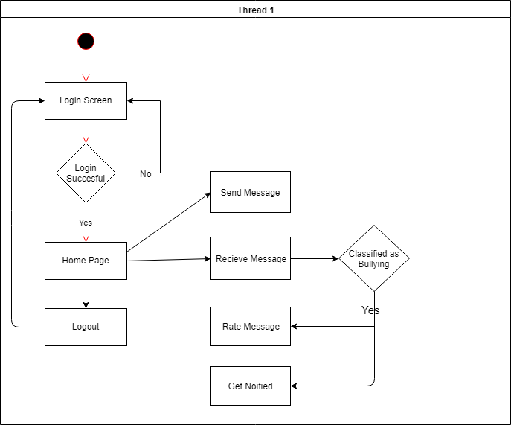
Activity Diagram

Slide 14
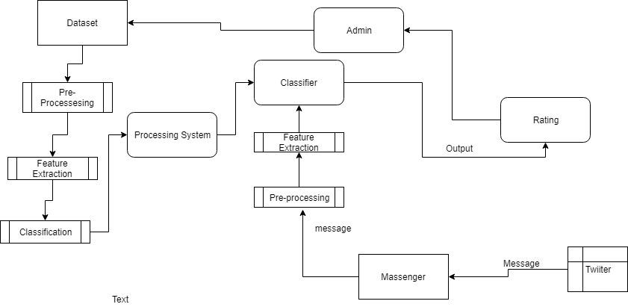
Data Flow Diagram

Slide 15
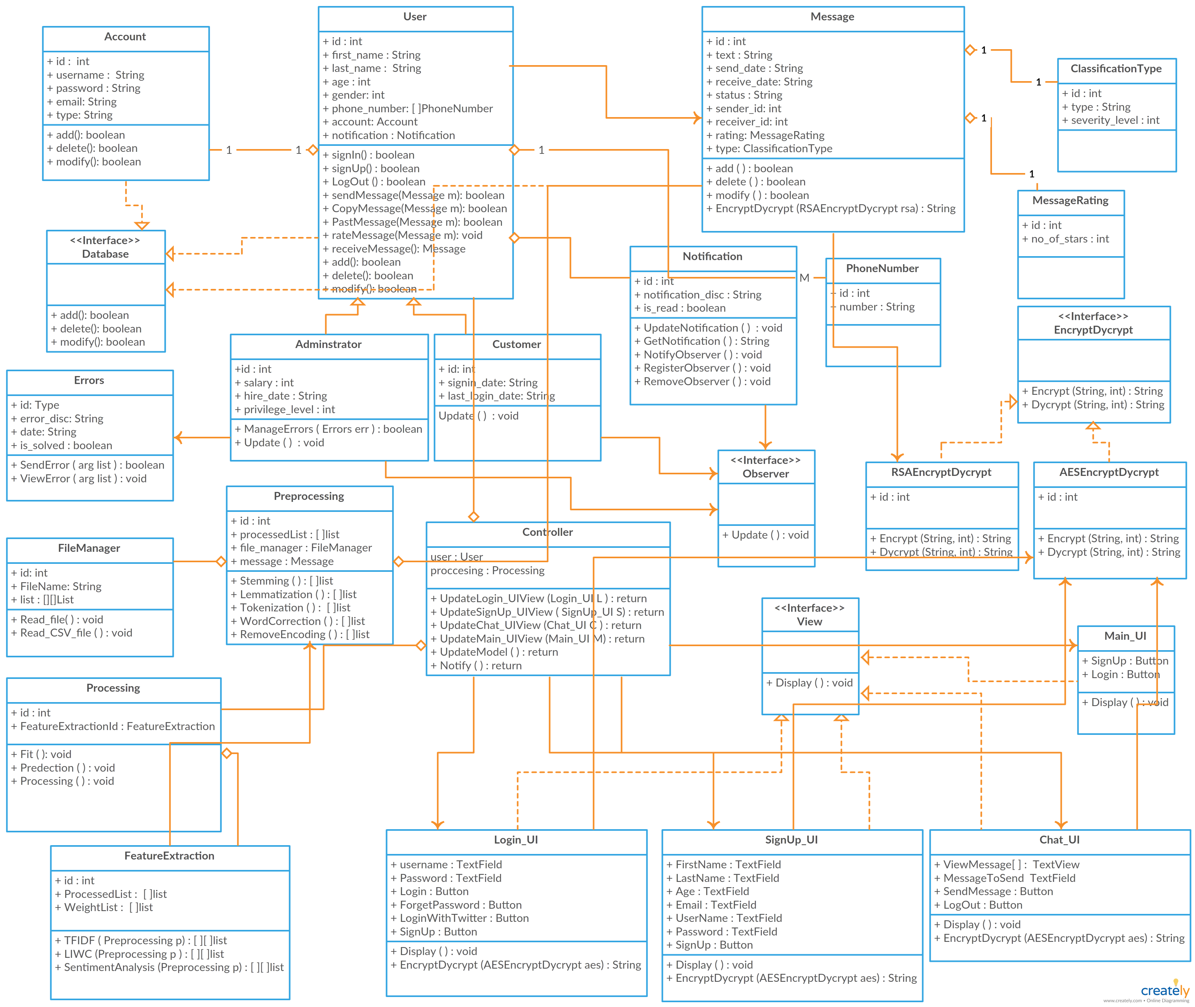
Class Diagram

Slide 16
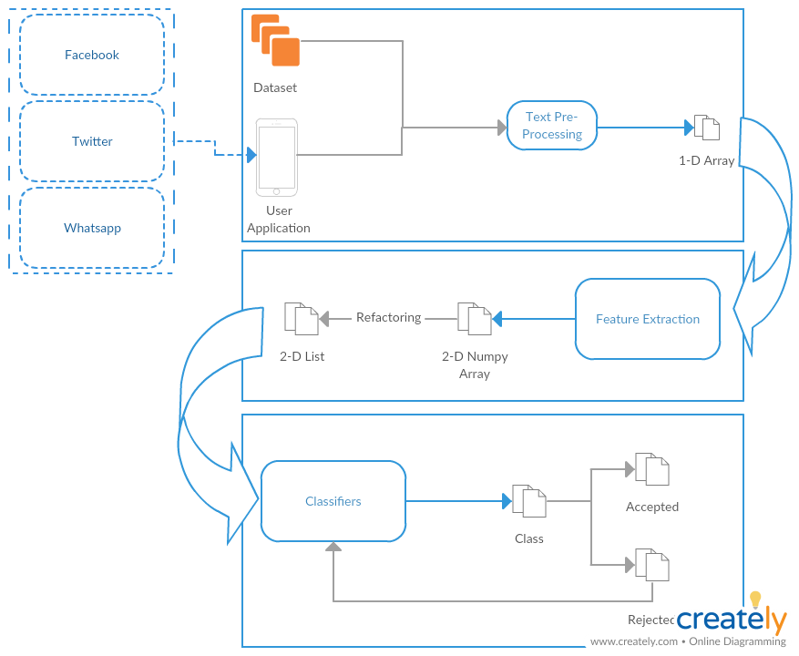
System Overview

Slide 17
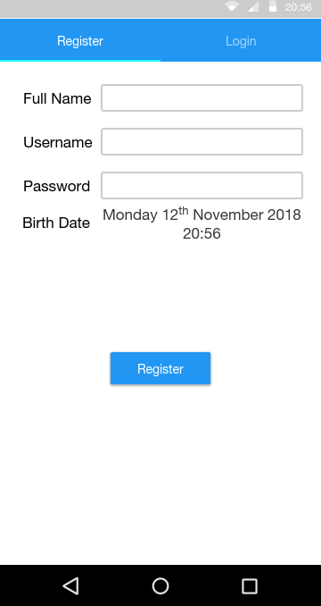
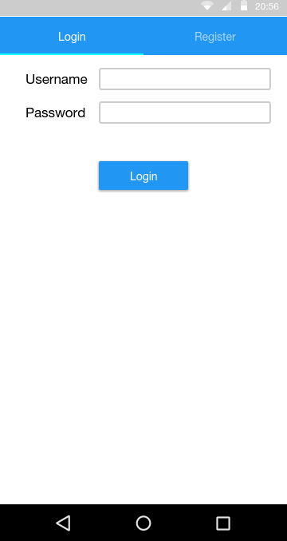
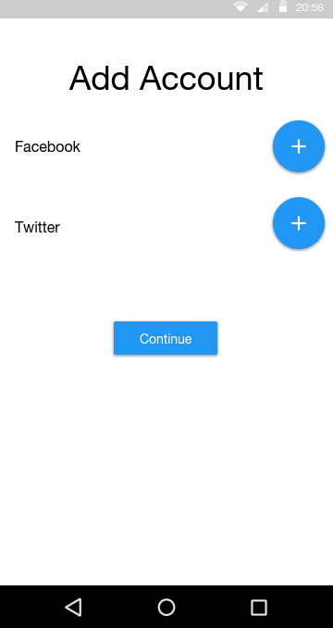
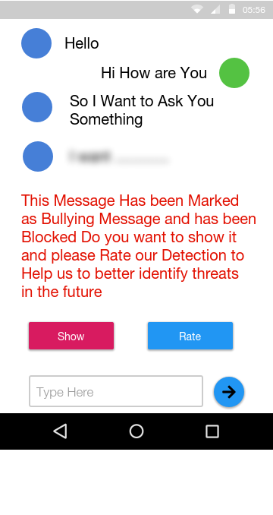
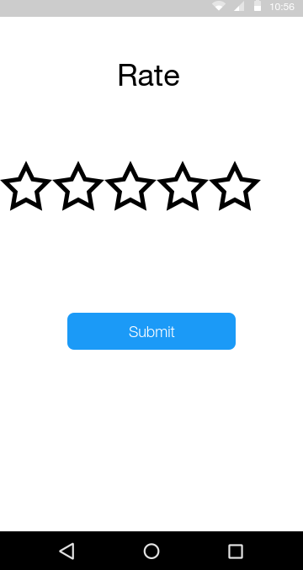
GUI

Slide 18
Demo

